Slide 1
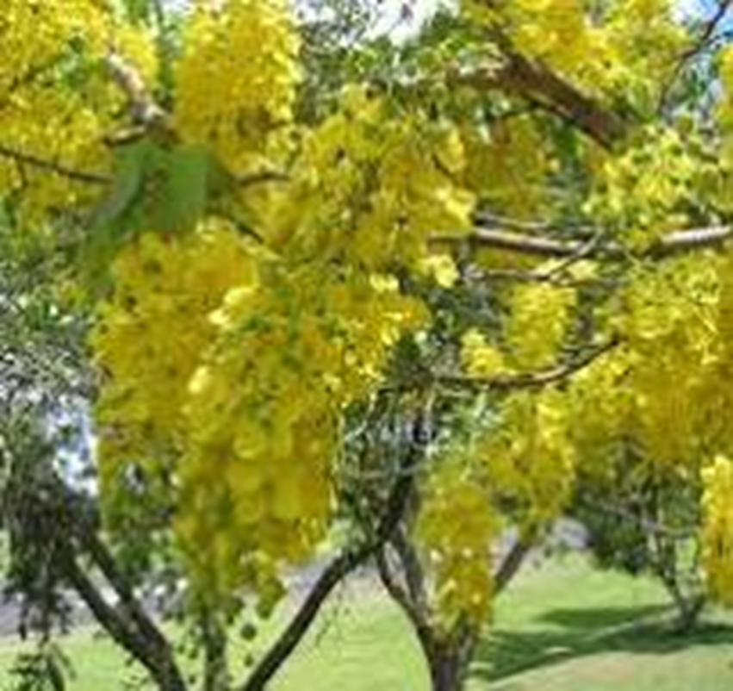
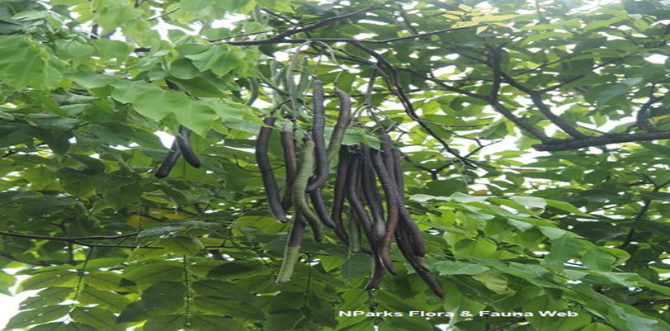
Golden Shower Tree

Slide 2
Common Name : Golden Shower Tree. Hindi name ‘Amaltas.’
Scientific Name : Cassia fistula
Family : Fabaceae
Habit : A medium-sized tree, up to 10 m tall, looks
magnificent when in full bloom.
Distribution : The species is native to the Indian subcontinent
and adjacent regions of Southeast Asia.

Slide 3
Description :
Height: 30 to 40 feet, with alternate leaf arrangement.
Trunk/branches: branches droop; not showy; typically one trunk; no thorns.
Bark: gray and smooth, becoming brownish and rough with age.
Fruit shape: cylindrical; pod or pod-like, elongated with length 1 to 2 feet.
Flower: yellow colour very showy; emerges in clusters 8"–18" long racemes
Flowering: During the hot weather (April-May) the tree becomes most conspicuous with its pendulous inflorescence of golden yellow, mildly scented flowers. The tree remains leafless at the commencement of flowering and the end of the flowering season; the leaves start to appear.

Slide 4
USES :
Cassia fistula is one of the best ornamental flowering trees fit for town roads.
Amaltas is suitable for the front row of the border planting in the campus of educational institutes like school, college or university.
Cassia fistula is strongly recommended to be planted along railway stations, railway lines, bus terminus, airports etc.
Amaltas (Golden yellow) can be altered along the avenues with Gulmohar (Orange-scarlet) and Jacaranda (Blue-mauve) as the flowering season of these trees synchronize with each other.
The wood is hard and heavy; it is used for cabinet, and inlay work. Wood is also used to make agricultural implements and tool handles.
The sweet blackish pulp of the ripened pod is used as a mild laxative to cure constipation.

